Slide 1
Introduction to Relational Model

Slide 2
Outline
Structure of Relational Databases
Database Schema
Keys
Schema Diagrams
Relational Query Languages
The Relational Algebra
Notes:
1
The relational model remains the primary data model for commercial data-processing applications.
It attained its primary position because of its simplicity, which eases the job of the programmer, compared to earlier data models such as the network model or the hierarchical model.
It has retained this position by incorporating various new features and capabilities over its half-century of existence.
Among those additions are object-relational features such as complex data types and stored procedures, support for XML data, and various tools to support semi-structured data.
The relational model’s independence from any specific underlying low-level data structures has allowed it to persist despite the advent of new approaches to data storage, including modern column stores that are designed for large-scale data mining.
In this chapter, we first study the fundamentals of the relational model. A substantial theory exists for relational databases. In Chapter 6 and Chapter 7, we shall examine aspects of database theory that help in the design of relational database schemas, while in Chapter 15 and Chapter 16 we discuss aspects of the theory dealing with efficient processing of queries. In Chapter 27, we study aspects of formal relational languages beyond our basic coverage in this chapter.

Slide 3
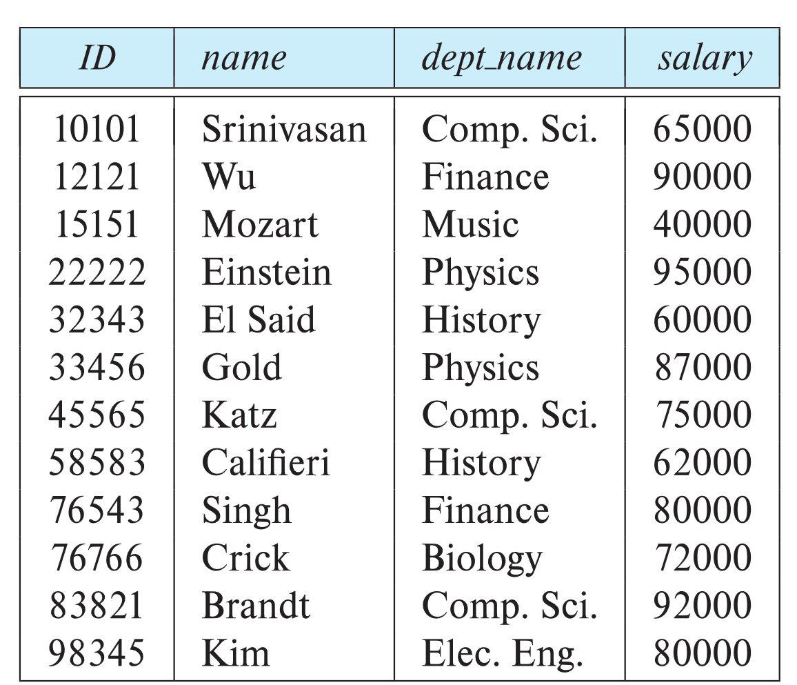
Example of a Instructor Relation
attributes
(or columns)
tuples
(or rows)
Notes:
A relational database consists of a collection of tables, each of which is assigned a unique name. For example, consider the instructor table of Figure 2.1, which stores information about instructors. The table has four column headers: ID, name, dept_name, and salary. Each row of this table records information about an instructor, consisting of the instructor’s ID, name, dept_name, and salary.
Similarly, the course table of Figure 2.2 stores information about courses, consisting of a course id, title, dept_name, and credits, for each course. Note that each instructor is identified by the value of the column ID, while each course is identified by the value of the column course id.

Slide 4
Relation Schema and Instance
A₁, A₂, …, A_{n} are attributes
R = (A₁, A₂, …, A_{n} ) is a relation schema
Example:
instructor = (ID, name, dept_name, salary)
A relation instance r defined over schema R is denoted by r (R).
The current values a relation are specified by a table
An element t of relation r is called a tuple and is represented by a row in a table
Notes:
1
In general, a row in a table represents a relationship among a set of values. Since a table is a collection of such relationships, there is a close correspondence between the concept of table and the mathematical concept of relation, from which the relational data model takes its name.
In mathematical terminology, a tuple is simply a sequence (or list) of values.
A relationship between n values is represented mathematically by an n-tuple of values, that is, a tuple with n values, which corresponds to a row in a table.
Thus, in the relational model the term relation is used to refer to a table, while the term tuple is used to refer to a row.
Similarly, the term attribute refers to a column of a table.
Examining Figure 2.1, we can see that the relation instructor has four attributes: ID, name, dept name, and salary. We use the term relation instance to refer to a specific instance of a relation, that is, containing a specific set of rows. The instance of instructor shown in Figure 2.1 has 12 tuples, corresponding to 12 instructors.
The order in which tuples appear in a relation is irrelevant, since a relation is a set of tuples. Thus, whether the tuples of a relation are listed in sorted order, as in Figure 2.1, or are unsorted
SLAJD

Slide 5
Attributes
The set of allowed values for each attribute is called the domain of the attribute
Attribute values are (normally) required to be atomic; that is, indivisible
The special value null is a member of every domain. Indicated that the value is “unknown”
The null value causes complications in the definition of many operations
Notes:
For each attribute of a relation, there is a set of permitted values, called the domain of that attribute.
Thus, the domain of the salary attribute of the instructor relation is the set of all possible salary values, while the domain of the name attribute is the set of all possible instructor names.
We require that, for all relations r, the domains of all attributes of r be atomic. A domain is atomic if elements of the domain are considered to be indivisible units. For example, suppose the table instructor had an attribute phone number, which can store a set of phone numbers corresponding to the instructor. Then the domain of phone number would not be atomic, since an element of the domain is a set of phone numbers, and it has subparts, namely, the individual phone numbers in the set.
The important issue is not what the domain itself is, but rather how we use domain elements in our database. Suppose now that the phone number attribute stores a single phone number. Even then, if we split the value from the phone number attribute into a country code, an area code, and a local number, we would be treating it as a non-atomic value. If we treat each phone number as a single indivisible unit, then the attribute phone number would have an atomic domain.
The null value is a special value that signifies that the value is unknown or does not exist. For example, suppose as before that we include the attribute phone number in the instructor relation. It may be that an instructor does not have a phone number at all, or that the telephone number is unlisted. We would then have to use the null value to signify that the value is unknown or does not exist. We shall see later that null values cause a number of difficulties when we access or update the database, and thus they should be eliminated if at all possible. We shall assume null values are absent initially, and in Section 3.6 we describe the effect of nulls on different operations.

Slide 6
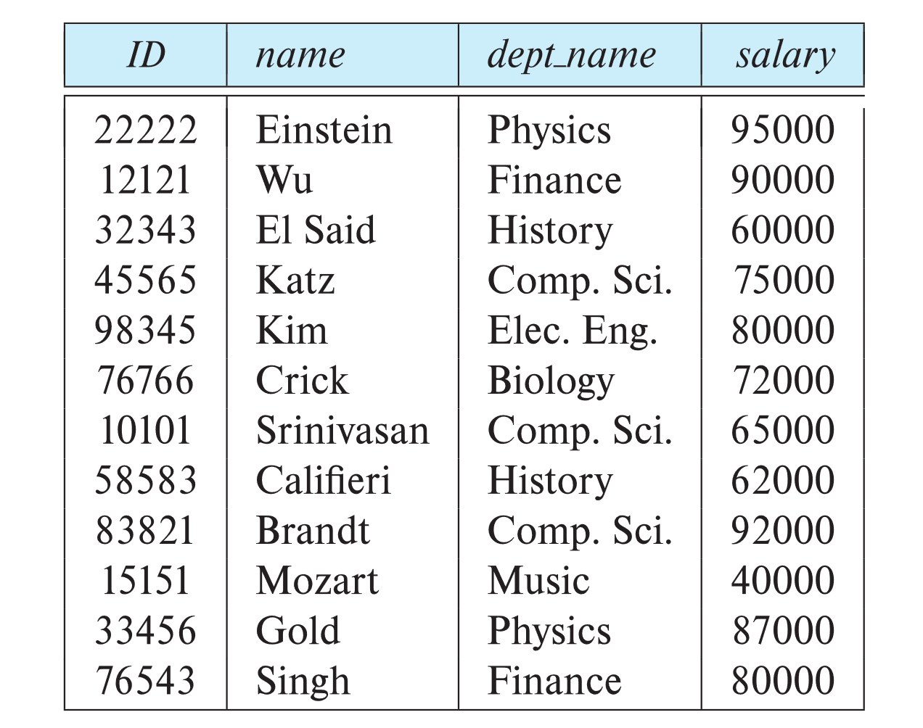
Relations are Unordered
Order of tuples is irrelevant (tuples may be stored in an arbitrary order)
Example: instructor relation with unordered tuples

Slide 7
Database Schema
Database schema -- is the logical structure of the database.
Database instance -- is a snapshot of the data in the database at a given instant in time.
Example:
schema: instructor (ID, name, dept_name, salary)
Instance:
Notes:
When we talk about a database, we must differentiate between the database schema, which is the logical design of the database, and the database instance, which is a snapshot of the data in the database at a given instant in time.
The concept of a relation corresponds to the programming-language notion of a variable, while the concept of a relation schema corresponds to the programming language notion of type definition. In general, a relation schema consists of a list of attributes and their corresponding domains.
The concept of a relation instance corresponds to the programming-language notion of a value of a variable. The value of a given variable may change with time; similarly the contents of a relation instance may change with time as the relation is updated. In contrast, the schema of a relation does not generally change.
Although it is important to know the difference between a relation schema and a relation instance, we often use the same name, such as instructor, to refer to both the schema and the instance. Where required, we explicitly refer to the schema or to the instance, for example “the instructor schema,” or “an instance of the instructor relation.” However, where it is clear whether we mean the schema or the instance, we simply use the relation name.
Ima uste 2 primera vo knigata

Slide 8
Keys
Let K ⊆ R
K is a superkey of R if values for K are sufficient to identify a unique tuple of each possible relation r(R)
Example: {ID} and {ID,name} are both superkeys of instructor.
Superkey K is a candidate key if K is minimal Example: {ID} is a candidate key for Instructor
One of the candidate keys is selected to be the primary key.
Which one?
Foreign key constraint: Value in one relation must appear in another
Referencing relation
Referenced relation
Example: dept_name in instructor is a foreign key from instructor referencing department
Notes:
We must have a way to specify how tuples within a given relation are distinguished. This is expressed in terms of their attributes. That is, the values of the attribute values of a tuple must be such that they can uniquely identify the tuple. In other words, no two tuples in a relation are allowed to have exactly the same value for all attributes.
A superkey is a set of one or more attributes that, taken collectively, allow us to identify uniquely a tuple in the relation. For example, the ID attribute of the relation instructor is sufficient to distinguish one instructor tuple from another. Thus, ID is a superkey. The name attribute of instructor, on the other hand, is not a superkey, because several instructors might have the same name.
Formally, let R denote the set of attributes in the schema of relation r. If we say that a subset K of R (relational schema) is a superkey for r, we are restricting consideration to instances of relations r in which no two distinct tuples have the same values on all attributes in K. That is, if t₁ and t₂ are in r and t1 ≠ t₂, then t₁.K ≠ t₂.K.
A superkey may contain extraneous attributes. For example, the combination of ID and name is a superkey for the relation instructor. If K is a superkey, then so is any superset of K. We are often interested in superkeys for which no proper subset is a superkey. Such minimal superkeys are called candidate keys.
It is possible that several distinct sets of attributes could serve as a candidate key. Suppose that a combination of name and dept_name is sufficient to distinguish among members of the instructor relation. Then, both {ID} and {name, dept name} are candidate keys. Although the attributes ID and name together can distinguish instructor tuples, their combination, {ID, name}, does not form a candidate key, since the attribute ID alone is a candidate key.
We shall use the term primary key to denote a candidate key that is chosen by the database designer as the principal means of identifying tuples within a relation. A key (whether primary, candidate, or super) is a property of the entire relation, rather than of the individual tuples. Any two individual tuples in the relation are prohibited from having the same value on the key attributes at the same time. The designation of a key represents a constraint in the real-world enterprise being modeled. Thus, primary keys are also referred to as primary key constraints.
A foreign-key constraint from attribute(s) A of relation r₁ to the primary-key B of relation r₂ states that on any database instance, the value of A for each tuple in r₁ must also be the value of B for some tuple in r₂. Attribute set A is called a foreign key from r₁, referencing r₂.
The relation r₁ is also called the referencing relation of the foreign-key constraint, and r₂ is called the referenced relation.
For example, the attribute dept_name in instructor is a foreign key from instructor, referencing department; note that dept_name is the primary key of department.

Slide 9
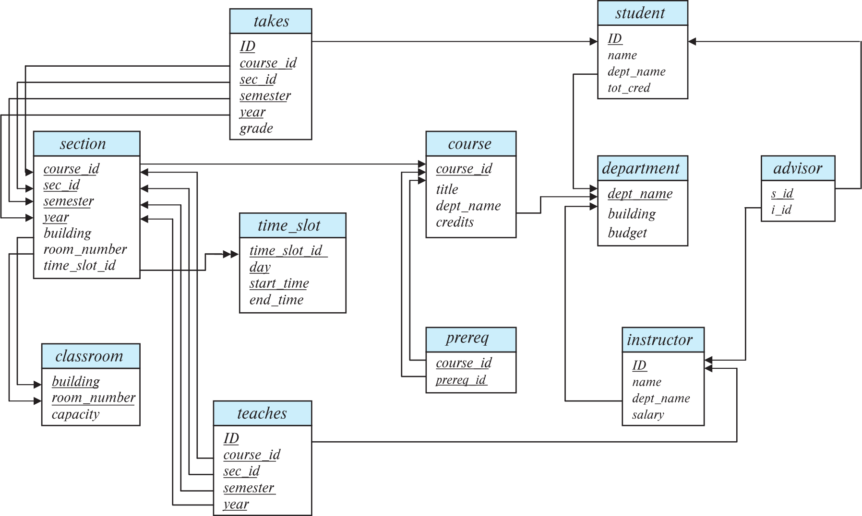
Schema Diagram for University Database
Notes:
A database schema, along with primary key and foreign-key constraints, can be depicted by schema diagrams. Figure 2.9 shows the schema diagram for our university organization. Each relation appears as a box, with the relation name at the top in blue and the attributes listed inside the box.
Primary-key attributes are shown underlined.
Foreign-key constraints appear as arrows from the foreign-key attributes of the referencing relation to the primary key of the referenced relation.
We use a two-headed arrow, instead of a single-headed arrow, to indicate a referential integrity constraint that is not a foreign-key constraints.
In Figure 2.9, the line with a two-headed arrow from time_slot_id in the section relation to time_slot_id in the time_slot relation represents the referential integrity constraint from section.time_slot_id to time slot.time_slot_id.
Many database systems provide design tools with a graphical user interface for creating schema diagrams.

Slide 10
Relational Query Languages
Procedural versus non-procedural, or declarative
“Pure” languages:
Relational algebra
Tuple relational calculus
Domain relational calculus
The above 3 pure languages are equivalent in computing power
We will concentrate in this chapter on relational algebra
Not Turing-machine equivalent
Consists of 6 basic operations
Notes:
A query language is a language in which a user requests information from the database. These languages are usually on a level higher than that of a standard programming language. Query languages can be categorized as imperative, functional, or declarative. In an imperative query language, the user instructs the system to perform a specific sequence of operations on the database to compute the desired result; such languages usually have a notion of state variables, which are updated in the course of the computation.
In a functional query language, the computation is expressed as the evaluation of functions that may operate on data in the database or on the results of other functions; functions are side-effect free, and they do not update the program state. In a declarative query language, the user describes the desired information without giving a specific sequence of steps or function calls for obtaining that information; the desired information is typically described using some form of mathematical logic. It is the job of the database system to figure out how to obtain the desired information.
There are a number of “pure” query languages.
The relational algebra, which we describe in Section 2.6, is a functional query language.4 The relational algebra forms the theoretical basis of the SQL query language.
The tuple relational calculus
and domain relational calculus, which we describe in Chapter 27 (available online) are declarative.

Slide 11
Relational Algebra
A procedural language consisting of a set of operations that take one or two relations as input and produce a new relation as their result.
Six basic operators
select: σ
project: ∏
union: ∪
set difference: –
Cartesian product: x
rename: ρ
Notes:
The relational algebra consists of a set of operations that take one or two relations as input and produce a new relation as their result.
Some of these operations, such as the select, project, and rename operations, are called unary operations because they operate on one relation.
The other operations, such as union, Cartesian product, and set difference, operate on pairs of relations and are, therefore, called binary operations.
Although the relational algebra operations form the basis for the widely used SQL query language, database systems do not allow users to write queries in relational algebra. However, there are implementations of relational algebra that have been built for students to practice relational algebra queries.
Dali tuka da se spomene ona za online sql od knigata
The website of our book, db-book.com, under the link titled Laboratory Material, provides pointers to a few such implementations.

Slide 12
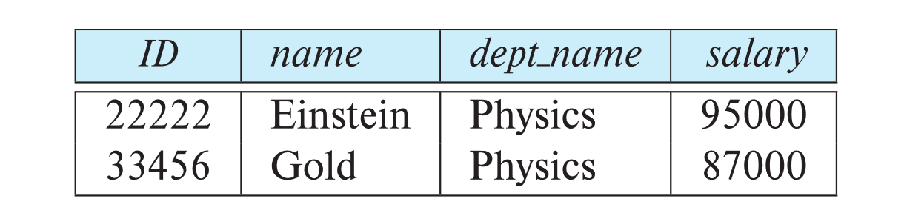
Select Operation
The select operation selects tuples that satisfy a given predicate.
Notation: σ _{p} (r)
p is called the selection predicate
Example: select those tuples of the instructor relation where the instructor is in the “Physics” department.
Query
σ _{dept_name=“Physics”} (instructor)
Result
Notes:
The select operation selects tuples that satisfy a given predicate. We use the lowercase Greek letter sigma (σ) to denote selection. The predicate appears as a subscript to σ. The argument relation is in parentheses after the σ. Thus, to select those tuples of the instructor relation where the instructor is in the “Physics” department, we write:
σ _{dept_name=“Physics”} (instructor)
If the instructor relation is as shown in Figure 2.1, then the relation that results from the preceding query is as shown in Figure 2.10.

Slide 13
Select Operation (Cont.)
We allow comparisons using
=, ≠, >, ≥. <. ≤
in the selection predicate.
We can combine several predicates into a larger predicate by using the connectives:
∧ (and), ∨ (or), ¬ (not)
Example: Find the instructors in Physics with a salary greater $90,000, we write:
σ _{dept_name=“Physics”} ∧ _{salary >} _{90,000} (instructor)
The select predicate may include comparisons between two attributes.
Example, find all departments whose name is the same as their building name:
σ _{dept_name=building} (department)
Notes:
In general, we allow comparisons using =, ≠, >, ≥. < , and ≥ in the selection predicate. Furthermore, we can combine several predicates into a larger predicate by using the connectives and (∧), or (∨), and not (¬).
Thus, to find the instructors In Physics with a salary greater than $90,000, we write:
σ _{dept_name=“Physics”} ∧ _{salary >} _{90,000} (instructor)
The selection predicate may include comparisons between two attributes. To illustrate, consider the relation department. To find all departments whose name is the same as their building name, we can write:
σ _{dept_name=building} (department)

Slide 14
Project Operation
A unary operation that returns its argument relation, with certain attributes left out.
Notation:
∏ _{A1,A2,A3 ….Ak} (r)
where A₁, A₂, …, A_{k} are attribute names and r is a relation name.
The result is defined as the relation of k columns obtained by erasing the columns that are not listed
Duplicate rows removed from result, since relations are sets
Notes:
Suppose we want to list all instructors’ ID, name, and salary, but we do not care about the dept_name. The project operation allows us to produce this relation. The project operation is a unary operation that returns its argument relation, with certain attributes left out. Since a relation is a set, any duplicate rows are eliminated. Projection is denoted by the uppercase Greek letter pi (Π). We list those attributes that we wish to appear in the result as a subscript to Π. The argument relation follows in parentheses. We write the query to produce such a list as:

Slide 15
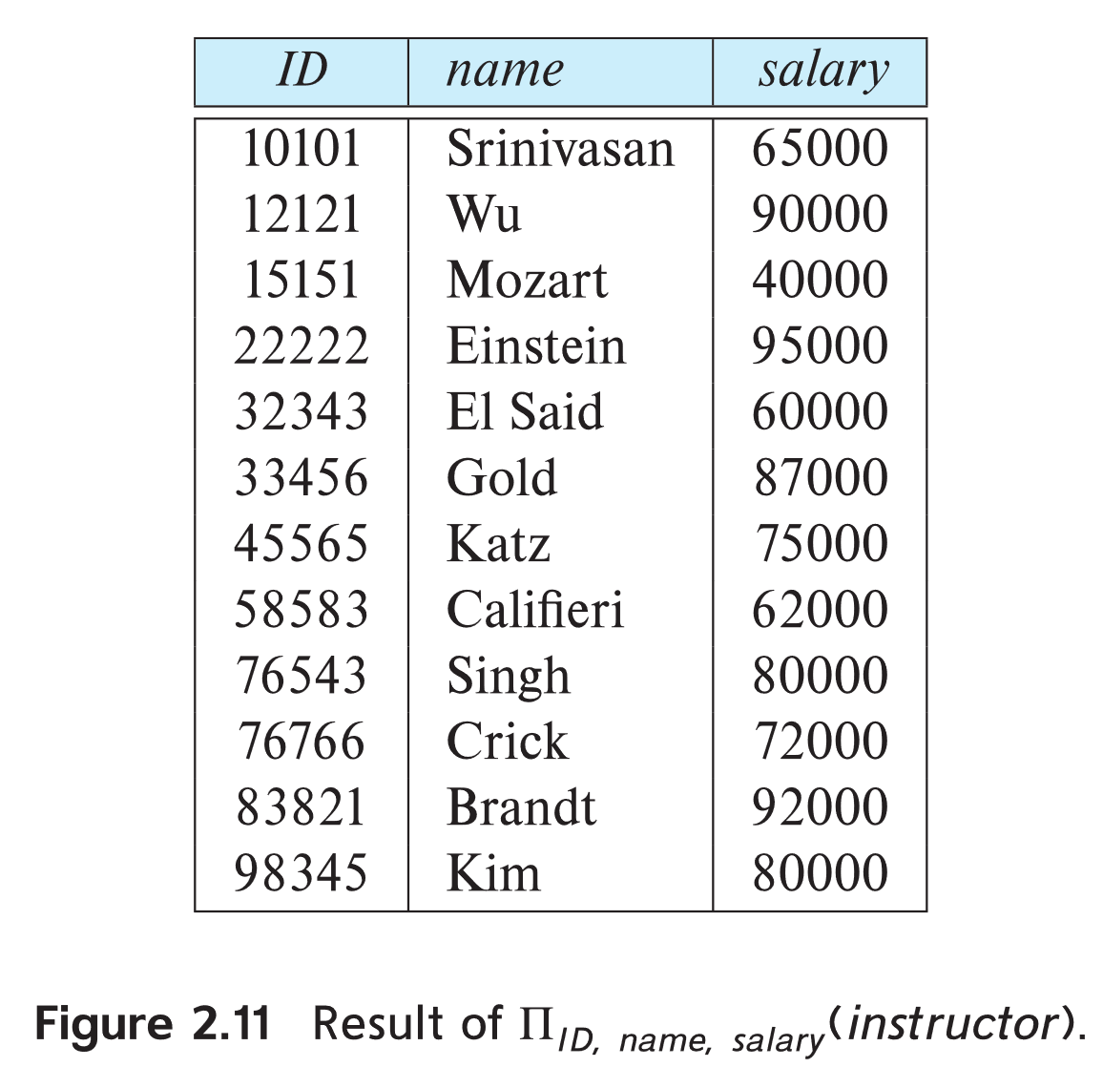
Project Operation Example
Example: eliminate the dept_name attribute of instructor
Query: ∏_{ID, name, salary} (instructor)
Result:
Notes:
Suppose we want to list all instructors’ ID, name, and salary, but we do not care about the dept_name. The project operation allows us to produce this relation. The project operation is a unary operation that returns its argument relation, with certain attributes left out. Since a relation is a set, any duplicate rows are eliminated. Projection is denoted by the uppercase Greek letter pi (Π). We list those attributes that we wish to appear in the result as a subscript to Π. The argument relation follows in parentheses. We write the query to produce such a list as:

Slide 16
Composition of Relational Operations
The result of a relational-algebra operation is relation and therefore of relational-algebra operations can be composed together into a relational-algebra expression.
Consider the query -- Find the names of all instructors in the Physics department.
∏_{name}(σ _{dept_name} _{=“Physics”} (instructor))
Instead of giving the name of a relation as the argument of the projection operation, we give an expression that evaluates to a relation.
Notes:
The fact that the result of a relational operation is itself a relation is important. Consider the more complicated query “Find the names of all instructors in the Physics department.” We write:
∏_{name}(σ _{dept_name} _{=“Physics”} (instructor))
Notice that, instead of giving the name of a relation as the argument of the projection operation, we give an expression that evaluates to a relation.
In general, since the result of a relational-algebra operation is of the same type (relation) as its inputs, relational-algebra operations can be composed together into a relational-algebra expression. Composing relational-algebra operations into relational algebra expressions is just like composing arithmetic operations (such as +, −, ∗, and ÷) into arithmetic expressions.

Slide 17
Cartesian-Product Operation
The Cartesian-product operation (denoted by X) allows us to combine information from any two relations.
Example: the Cartesian product of the relations instructor and teaches is written as:
instructor X teaches
We construct a tuple of the result out of each possible pair of tuples: one from the instructor relation and one from the teaches relation (see next slide)
Since the instructor ID appears in both relations we distinguish between these attribute by attaching to the attribute the name of the relation from which the attribute originally came.
instructor.ID
teaches.ID
Notes:
The Cartesian-product operation, denoted by a cross (×), allows us to combine information from any two relations. We write the Cartesian product of relations r₁ and r₂ as r₁ × r₂.
Since the same attribute name may appear in the schemas of both r₁ and r₂, we need to devise a naming schema to distinguish between these attributes. We do so here by attaching to an attribute the name of the relation from which the attribute originally came. For example, the relation schema for r = instructor × teaches is:
(instructor.ID, instructor.name, instructor.dept_name, instructor.salary, teaches.ID, teaches.course id, teaches.sec id, teaches.semester, teaches.year)
Now that we know the relation schema for r = instructor × teaches, what tuples appear in r? As you may suspect, we construct a tuple of r out of each possible pair of tuples: one from the instructor relation (Figure 2.1) and one from the teaches relation (Figure 2.7). Thus, r is a large relation, as you can see from Figure 2.12, which includes only a portion of the tuples that make up r.
Assume that we have n1 tuples in instructor and n2 tuples in teaches. Then, there are n1 ∗ n2 ways of choosing a pair of tuples—one tuple from each relation; so there are n1 ∗ n2 tuples in r. In particular for our example, for some tuples t in r, it may be that the two ID values, instructor.ID and teaches.ID, are different.

Slide 18
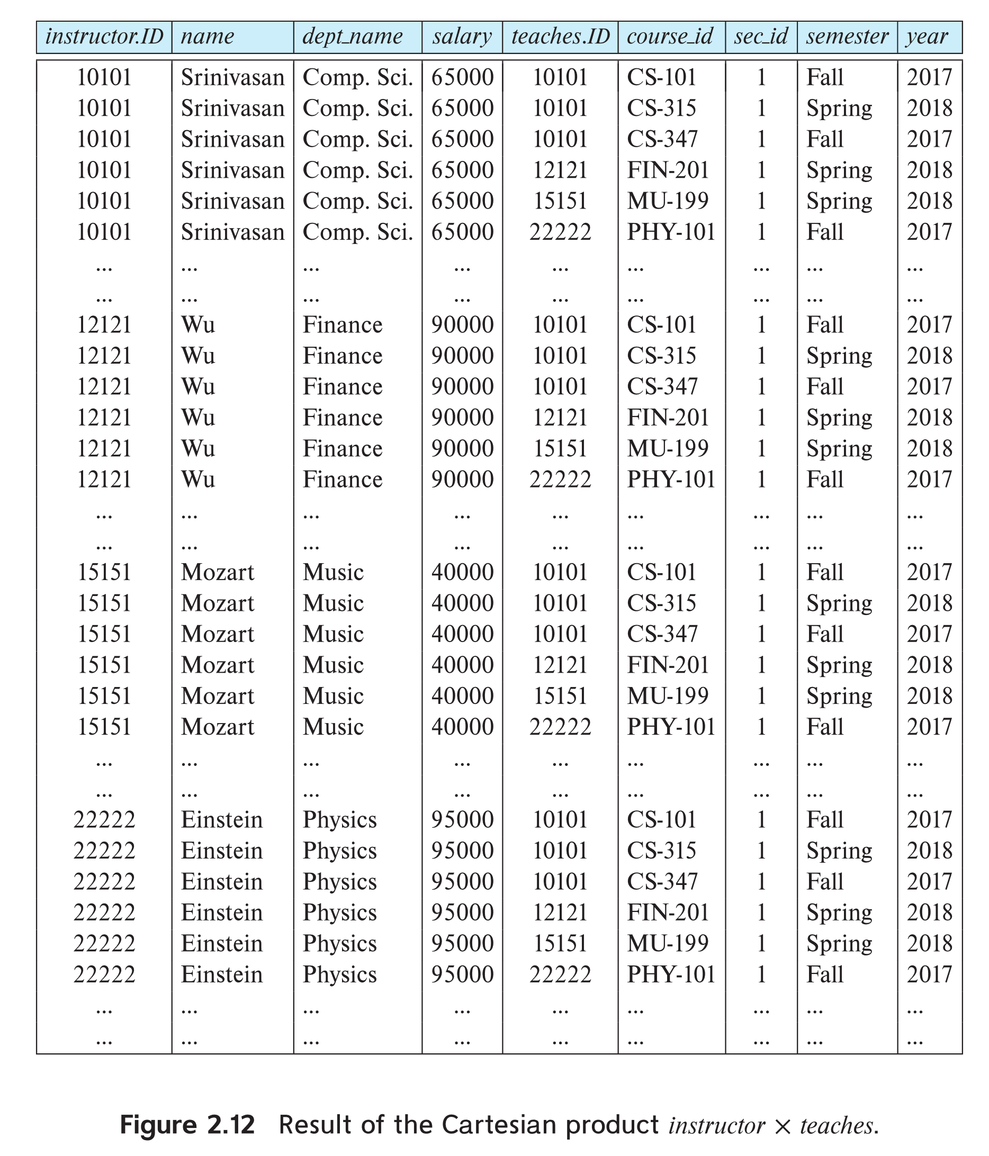
The instructor X teaches table
Notes:
Now that we know the relation schema for r = instructor × teaches, what tuples appear in r?
As you may suspect, we construct a tuple of r out of each possible pair of tuples: one from the instructor relation (Figure 2.1) and one from the teaches relation (Figure 2.7). Thus, r is a large relation, as you can see from Figure 2.12, which includes only a portion of the tuples that make up r.
Assume that we have n₁ tuples in instructor and n₂ tuples in teaches. Then, there are n₁ ∗ n₂ ways of choosing a pair of tuples—one tuple from each relation; so there are n1 ∗ n2 tuples in r. In particular for our example, for some tuples t in r, it may be that the two ID values, instructor.ID and teaches.ID, are different.
In general, if we have relations r₁(R₁) and r₂(R₂), then r₁ × r₂ is a relation r(R) whose schema R is the concatenation of the schemas R₁ and R₂. Relation r contains all tuples t for which there is a tuple t1 in r₁ and a tuple t₂ in r₂ for which t and t₁ have the same value on the attributes in R₁ and t and t₂ have the same value on the attributes in R₂.

Slide 19
Join Operation
The Cartesian-Product
instructor X teaches
associates every tuple of instructor with every tuple of teaches.
Most of the resulting rows have information about instructors who did NOT teach a particular course.
To get only those tuples of “instructor X teaches “ that pertain to instructors and the courses that they taught, we write:
σ _{instructor.id = teaches.id} (instructor x teaches ))
We get only those tuples of “instructor X teaches” that pertain to instructors and the courses that they taught.
The result of this expression, shown in the next slide
Notes:
Suppose we want to find the information about all instructors together with the course_id of all courses they have taught. We need the information in both the instructor relation and the teaches relation to compute the required result. The Cartesian product of instructor and teaches does bring together information from both these relations, but unfortunately the Cartesian product associates every instructor with every course that was taught, regardless of whether that instructor taught that course.
Since the Cartesian-product operation associates every tuple of instructor with every tuple of teaches, we know that if an instructor has taught a course (as recorded in the teaches relation), then there is some tuple in instructor × teaches that contains her name and satisfies instructor.ID = teaches.ID. So, if we write:
σ _{instructor.id = teaches.id} (instructor x teaches ))
we get only those tuples of instructor × teaches that pertain to instructors and the courses that they taught.

Slide 20
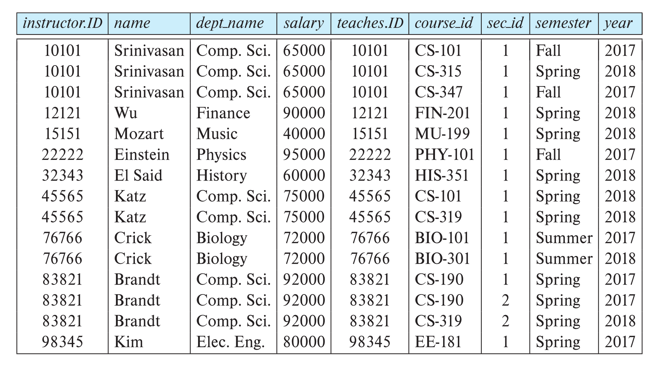
Join Operation (Cont.)
The table corresponding to:
σ _{instructor.id = teaches.id} (instructor x teaches))
Notes:
The result of this expression is shown in Figure 2.13. Observe that instructors Gold, Califieri, and Singh do not teach any course (as recorded in the teaches relation), and therefore do not appear in the result.
Note that this expression results in the duplication of the instructor’s ID. This can be easily handled by adding a projection to eliminate the column teaches.ID.

Slide 21
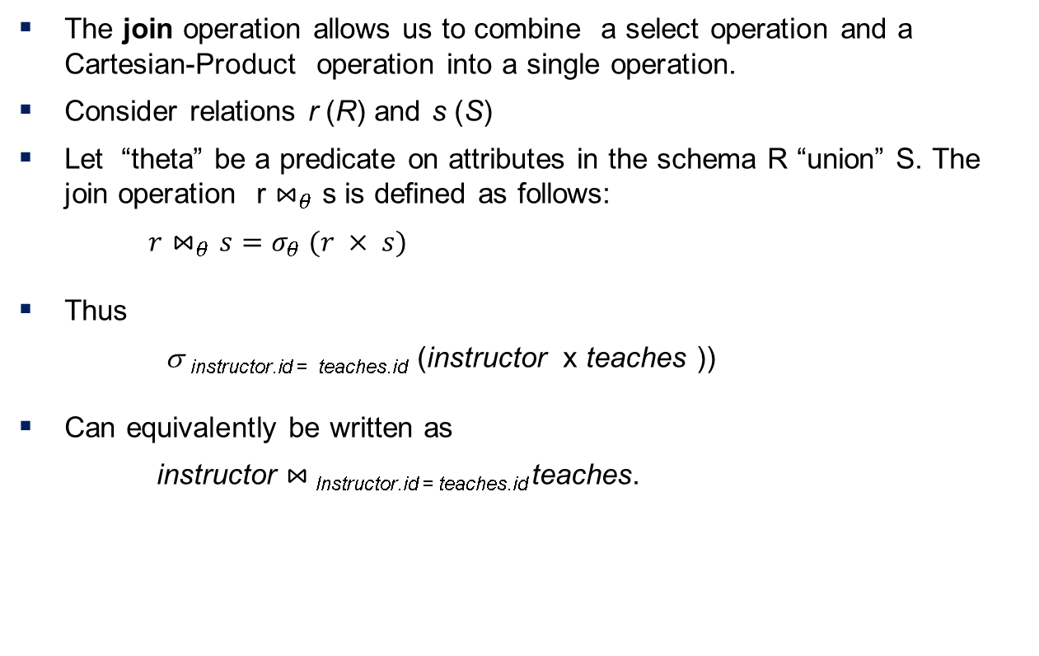
Join Operation (Cont.)
The join operation allows us to combine a select operation and a Cartesian-Product operation into a single operation.
Consider relations r (R) and s (S)
Let “theta” be a predicate on attributes in the schema R “union” S. The join operation r $⋈_{θ}$ s is defined as follows:
$r⋈_{θ}s=σ_{θ} (r × s)$
Thus
σ _{instructor.id = teaches.id} (instructor x teaches ))
Can equivalently be written as
instructor $⋈_{ }$_{Instructor.id = teaches.id} teaches.
Notes:
Consider relations r(R) and s(S), and let θ be a predicate on attributes in the schema R ∪ S. The join operation r ⋈θ s is defined as follows:
$$r⋈_{θ}s=σ_{θ} (r × s)$$
Thus
σ _{instructor.id = teaches.id} (instructor x teaches ))
Can equivalently be written as
instructor $⋈_{ }$_{Instructor.id = teaches.id} teaches.

Slide 22
Union Operation
The union operation allows us to combine two relations
Notation: r ∪ s
For r ∪ s to be valid.
1. r, s must have the same arity (same number of attributes)
2. The attribute domains must be compatible (example: 2nd
column of r deals with the same type of values as does the
2nd column of s)
Example: to find all courses taught in the Fall 2017 semester, or in the Spring 2018 semester, or in both ∏_{course_id} (σ _{semester=“Fall” Λ year=2017} (section)) ∪ ∏_{course_id} (σ _{semester=“Spring” Λ year=2018} (section))
Notes:
Set Operations
Consider a query to find the set of all courses taught in the Fall 2017 semester, the Spring 2018 semester, or both. The information is contained in the section relation (Figure 2.6). To find the set of all courses taught In the Fall 2017 semester, we write:
∏_{course_id} (σ _{semester=“Fall” Λ year=2017} (section))
To find the set of all courses taught in the Spring 2018 semester, we write:
∏_{course_id} (σ _{semester=“Spring” Λ year=2018} (section))
To answer the query, we need the union of these two sets; that is, we need all course ids that appear in either or both of the two relations. We find these data by the binary operation union, denoted, as in set theory, by ∪. So the expression needed is:
∏_{course_id} (σ _{semester=“Fall” Λ year=2017} (section)) ∪ ∏_{course_id} (σ _{semester=“Spring” Λ year=2018} (section))
The result relation for this query appears in Figure next slide (2.14). Notice that there are eight tuples in the result, even though there are three distinct courses offered in the Fall 2017 semester and six distinct courses offered in the Spring 2018 semester. Since relations are sets, duplicate values such as CS-101, which is offered in both semesters, are replaced by a single occurrence

Slide 23
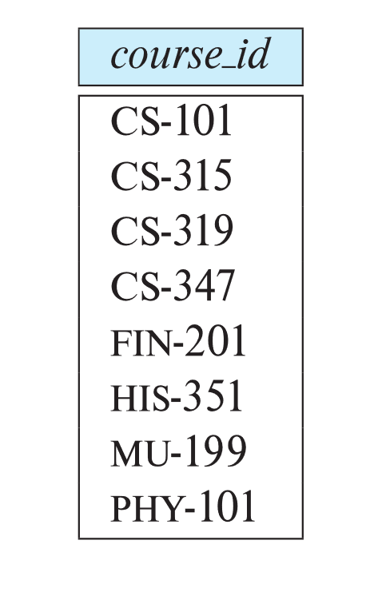
Union Operation (Cont.)
Result of: ∏_{course_id} (σ _{semester=“Fall” Λ year=2017} (section)) ∪ ∏_{course_id} (σ _{semester=“Spring” Λ year=2018} (section))
Notes:
Notice that there are eight tuples in the result, even though there are three distinct courses offered in the Fall 2017 semester and six distinct courses offered in the Spring 2018 semester. Since relations are sets, duplicate values such as CS-101, which is offered in both semesters, are replaced by a single occurrence
Observe that, in our example, we took the union of two sets, both of which consisted of course_id values.
In general, for a union operation to make sense:
We must ensure that the input relations to the union operation have the same number of attributes; the number of attributes of a relation is referred to as its arity.
When the attributes have associated types, the types of the i-th attributes of both input relations must be the same, for each i.
Such relations are referred to as compatible relations.
For example, it would not make sense to take the union of the instructor and section relations, since they have different numbers of attributes. And even though the instructor and the student relations both have arity 4, their 4th attributes, namely, salary and tot cred, are of two different types. The union of these two attributes would not make sense in most situations

Slide 24
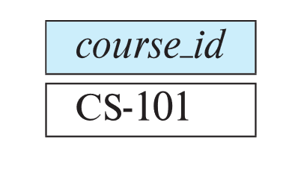
Set-Intersection Operation
The set-intersection operation allows us to find tuples that are in both the input relations.
Notation: r ∩ s
Assume:
r, s have the same arity
attributes of r and s are compatible
Example: Find the set of all courses taught in both the Fall 2017 and the Spring 2018 semesters.
∏_{course_id} (σ _{semester=“Fall” Λ year=2017} (section)) ∩ ∏_{course_id} (σ _{semester=“Spring” Λ year=2018} (section))
Result
Notes:
The intersection operation, denoted by ∩, allows us to find tuples that are in both the input relations. The expression r ∩ s produces a relation containing those tuples in r as well as in s. As with the union operation, we must ensure that intersection is done between compatible relations.
Suppose that we wish to find the set of all courses taught in both the Fall 2017 and the Spring 2018 semesters. Using set intersection, we can write:
∏_{course_id} (σ _{semester=“Fall” Λ year=2017} (section)) ∩ ∏_{course_id} (σ _{semester=“Spring” Λ year=2018} (section))
The result relation for this query appears in Figure 2.15.

Slide 25

Set Difference Operation
The set-difference operation allows us to find tuples that are in one relation but are not in another.
Notation r – s
Set differences must be taken between compatible relations.
r and s must have the same arity
attribute domains of r and s must be compatible
Example: to find all courses taught in the Fall 2017 semester, but not in the Spring 2018 semester ∏_{course_id} (σ _{semester=“Fall” Λ year=2017} (section)) − ∏_{course_id} (σ _{semester=“Spring” Λ year=2018} (section))
Notes:
The set-difference operation, denoted by −, allows us to find tuples that are in one relation but are not in another. The expression r − s produces a relation containing those tuples in r but not in s.
We can find all the courses taught in the Fall 2017 semester but not in Spring 2018 semester by writing:
∏_{course_id} (σ _{semester=“Fall” Λ year=2017} (section)) − ∏_{course_id} (σ _{semester=“Spring” Λ year=2018} (section))
The result relation for this query appears in Figure 2.16.
As with the union operation, we must ensure that set differences are taken between compatible relations.

Slide 26
The Assignment Operation
It is convenient at times to write a relational-algebra expression by assigning parts of it to temporary relation variables.
The assignment operation is denoted by ← and works like assignment in a programming language.
Example: Find all instructor in the “Physics” and Music department. Physics ← σ _{dept_name=“Physics”} (instructor)
Music ← σ _{dept_name=“Music”} (instructor)
Physics ∪ Music
With the assignment operation, a query can be written as a sequential program consisting of a series of assignments followed by an expression whose value is displayed as the result of the query.
Notes:
It is convenient at times to write a relational-algebra expression by assigning parts of it to temporary relation variables. The assignment operation, denoted by ← (arrow to the left side), works like assignment in a programming language. To illustrate this operation, consider the query to find courses that run in Fall 2017 as well as Spring 2018, which we saw earlier. We could write it as:
Physics ← σ _{dept_name=“Physics”} (instructor)
Music ← σ _{dept_name=“Music”} (instructor)
Physics ∪ Music
The final line above displays the query result. The preceding two lines assign the query result to a temporary relation. The evaluation of an assignment does not result in any relation being displayed to the user. Rather, the result of the expression to the right of the ← is assigned to the relation variable on the left of the ←. This relation variable may be used in subsequent expressions.
With the assignment operation, a query can be written as a sequential program consisting of a series of assignments followed by an expression whose value is displayed as the result of the query. For relational-algebra queries, assignment must always be made to a temporary relation variable. Assignments to permanent relations constitute a database modification. Note that the assignment operation does not provide any additional power to the algebra. It is, however, a convenient way to express complex queries.

Slide 27
The Rename Operation
The results of relational-algebra expressions do not have a name that we can use to refer to them. The rename operator, ρ , is provided for that purpose
The expression:
ρ_{x} (E)
returns the result of expression E under the name x
Another form of the rename operation:
ρ_{x(A1,A2, .. An)} (E)
Notes:
Unlike relations in the database, the results of relational-algebra expressions do not have a name that we can use to refer to them. It is useful in some cases to give them names; the rename operator, denoted by the lowercase Greek letter rho (ρ), lets us do this. Given a relational-algebra expression E, the expression:
ρ_{x} (E)
A second form of the rename operation is as follows: Assume that a relational algebra expression E has arity n. Then, the expression
ρ_{x(A1,A2, .. An)} (E)
returns the result of expression E under the name x, and with the attributes renamed to A1, A2, …, An. This form of the rename operation can be used to give names to attributes in the results of relational algebra operations that involve expressions on attributes.

Slide 28
Equivalent Queries
There is more than one way to write a query in relational algebra.
Example: Find information about courses taught by instructors in the Physics department with salary greater than 90,000
Query 1
σ _{dept_name=“Physics”} ∧ _{salary > 90,000} (instructor)
Query 2
σ _{dept_name=“Physics”} (σ _{salary > 90.000} (instructor))
The two queries are not identical; they are, however, equivalent -- they give the same result on any database.

Slide 29
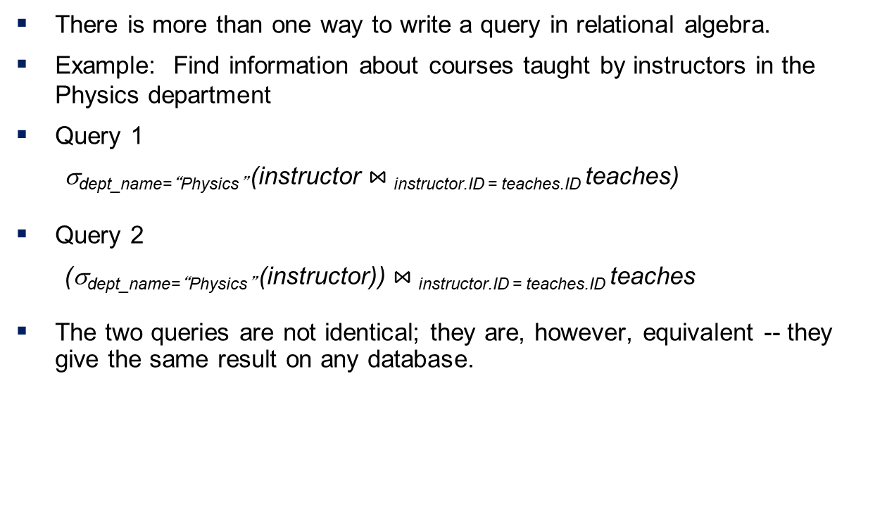
Equivalent Queries
There is more than one way to write a query in relational algebra.
Example: Find information about courses taught by instructors in the Physics department
Query 1
σ_{dept_name=“Physics”} (instructor $⋈_{ }$_{instructor.ID = teaches.ID} teaches)
Query 2
(σ_{dept_name=“Physics”} (instructor)) $⋈_{ }$_{instructor.ID = teaches.ID} teaches
The two queries are not identical; they are, however, equivalent -- they give the same result on any database.
Notes:
Note that there is often more than one way to write a query in relational algebra. Consider the following query, which finds information about courses taught by instructors in the Physics department:
σ_{dept_name=“Physics”} (instructor $⋈_{ }$_{instructor.ID = teaches.ID} teaches)
Now consider an alternative query:
(σ_{dept_name=“Physics”} (instructor)) $⋈_{ }$_{instructor.ID = teaches.ID} teaches
Note the subtle difference between the two queries: in the first query, the selection that restricts dept_name to Physics is applied after the join of instructor and teaches has been computed, whereas in the second query, the selection that restricts dept_name to Physics is applied to instructor, and the join operation is applied subsequently.
Although the two queries are not identical, they are in fact equivalent; that is, they give the same result on any database

Slide 30
End

